Slide 1
Data Structures and Algorithms
LECTURE 07: BINARY TREE

Slide 2
Definitions

Slide 3
What is a tree?
A tree is an abstract model of a hierarchical structure
A tree consists of nodes with parent-child relation
Inspiration: family trees
Applications:
Organization charts
File systems
Programming environments
Every node except one (a root) has a unique parent

Slide 4
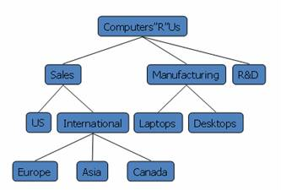
Exact (Formal) definition
Empty structure is an empty tree
Non-empty tree consists of a root and its children, where these children are also trees

Slide 5
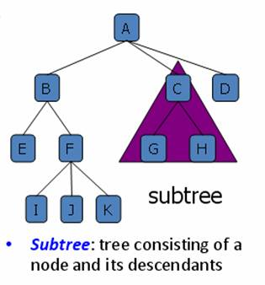
Given a tree

Slide 6
Tree Terminologies
Root: unique node without a parent
Internal node: node with at least one child (A, B, C, F)
Leaf: node without children (E, I, J, K, G, H, D)
Ancestors: parent, grandparent, great-grand-parent, …
Descendants: child, grandchild, great-grandchild, etc.
Level: a root is at level 1 (sometimes 0).
A father is level i then its children are at level i+1
Height: maximum level in a tree
Empty tree is a legitimate tree of height 0 (by definition)
A single node is a tree of height 1
Degree (order): number of its children
Each node has to be reachable from the root through a unique sequence of arcs, called path.
The number of arcs in a path is called the length of the path.

Slide 7
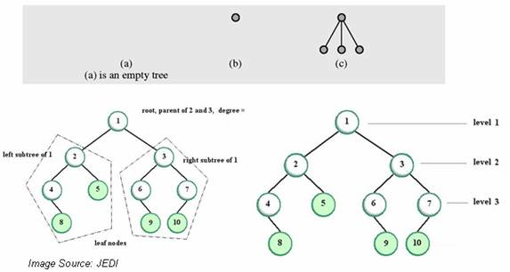
Tree examples

Slide 8
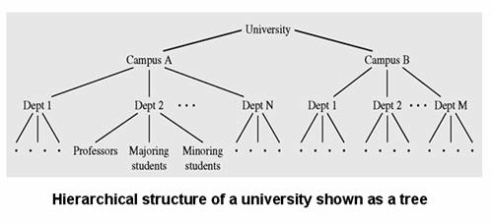
Tree examples

Slide 9
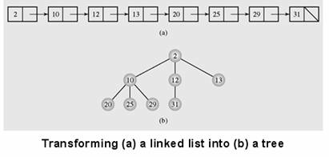
Linked List to Tree Conversion
Linked List can be converted into orderly tree
All elements are stored according to some order
However, from searching point of view, it is not better than a linked list (if it doesn’t consist some additional constraints regarding arrangement of nodes)

Slide 10
Binary tree
Definition, Types, Traversal

Slide 11
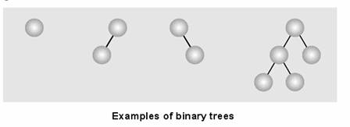
Binary Trees
Binary tree: each node has at most two children
Empty tree is a binary tree
Each child may be empty or designated as either left child or right child

Slide 12
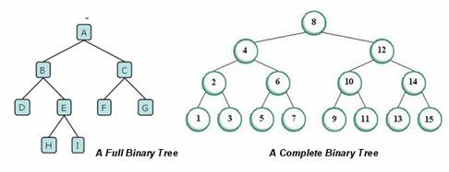
Types of Binary Trees
Full binary tree (sometimes proper binary tree or 2-tree): every node other than the leaves has two children
Complete binary tree: all non-terminal nodes have both children, and all leaves are at the same level

Slide 13
Tree Traversal
Tree traversal:
Process of visiting each node in the tree exactly one time
Breadth-first traversal:
Visiting each node starting from lowest (or highest) level and moving down (or up) level by level
Visiting nodes on each level from left to right (or from right to left)

Slide 14
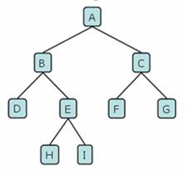
Breadth-first Tree traversal example
Bread-first traversal:
A, B, C, D, E, F, G, H, I

Slide 15
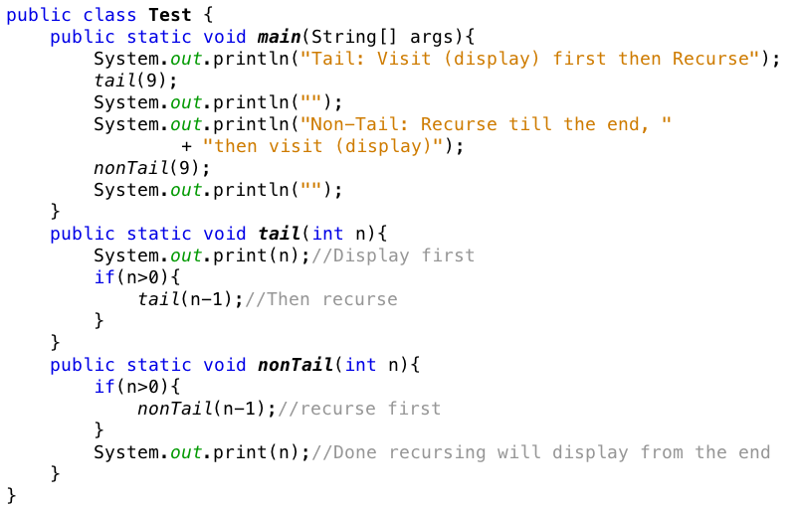
Tutorial: visit first or recursive call first

Slide 16
Tree traversal
Depth-first traversal:
Proceeds as far as possible to the left (or right)
Then backs up until the first crossroad
Goes one step to the right (or left)
Again, as far as possible to the left (or right)
There are three tasks to be done:
V: Visiting a node
L: Traversing the left subtree
R: Traversing the right subtree

Slide 17
Ways of depth-first traversal
Three tasks can be ordered in 3!=6 ways
There are 6 possible ordered depth-first traversals
It can be reduced to 3 traversals
The move is always from left to right and
Attention is focused on the first column.
The 3 traversals are given these standard names
VLR: Preorder traversal (or NLR)
LVR: Inorder traversal (or LNR)
LRV: Postorder (or LRN)
Notes:
Left Node Right

Slide 18
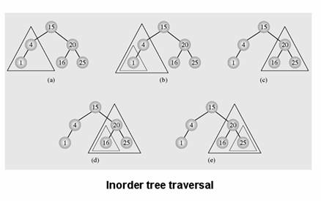
Inorder tree traversal

Slide 19
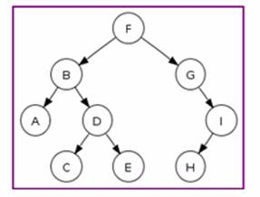
Tree Traversal Example
Preorder traversal: F, B, A, D, C, E, G, I, H (root, left, right)
Inorder traversal: A, B, C, D, E, F, G, H, I (left, root, right)
Postorder traversal: A, C, E, D, B, H, I, G, F (left, right, root)
Level-order traversal (breadth-first): F, B, G, A, D, I, C, E, H

Slide 20
Binary tree implementation

Slide 21
Array - Binary tree implementation
Binary trees can be implemented at least in two ways
As arrays
As linked structures
To implement tree as an array
A node is declared as an object with
Information field and
Two reference fields
These reference fields contain the indexes of the array cells in which the left and the right children are stored, if any.
It is hard to predict how many nodes will be created during program execution
How to reserve spaces and know the size to define an array?

Slide 22
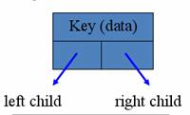
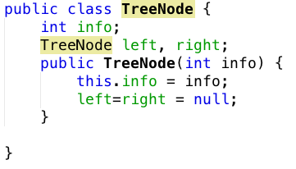
Linked - Binary tree implementation
Linked structure implementation
A node is declared as an object with
Information field and
Two reference fields

Slide 23
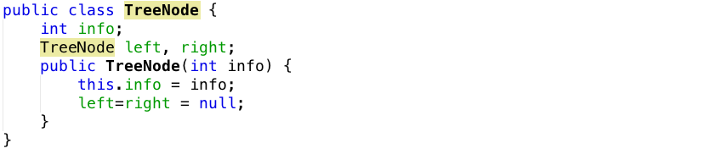
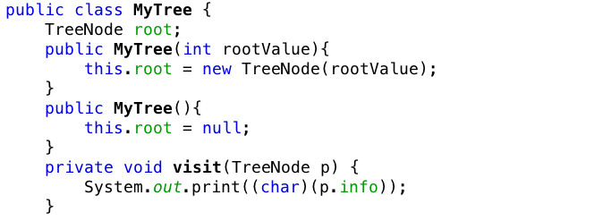
Tree Implementation

Slide 24
Breadth-first Algorithm
Put the root node into the queue
Repeat following steps (till no more node in the queue to process)
Dequeue the node from the queue
Put its children (if there’s) into the queue
Display value of the node
F
Output:

Slide 25
Breadth-first Algorithm
Put the root node into the queue
Repeat following steps (till no more node in the queue to process)
Dequeue the node from the queue
Put its children (if there’s) into the queue
Display value of the node
F
Output:

Slide 26
Breadth-first Algorithm
Put the root node into the queue
Repeat following steps (till no more node in the queue to process)
Dequeue the node from the queue
Put its children (if there’s) into the queue
Display value of the node
B
G
Output:
F
F

Slide 27
Breadth-first Algorithm
Put the root node into the queue
Repeat following steps (till no more node in the queue to process)
Dequeue the node from the queue
Put its children (if there’s) into the queue
Display value of the node
B
G
Output:
F

Slide 28
Breadth-first Algorithm
Put the root node into the queue
Repeat following steps (till no more node in the queue to process)
Dequeue the node from the queue
Put its children (if there’s) into the queue
Display value of the node
G
A
D
Output:
F
B

Slide 29
Breadth-first Algorithm
Put the root node into the queue
Repeat following steps (till no more node in the queue to process)
Dequeue the node from the queue
Put its children (if there’s) into the queue
Display value of the node
G
A
D
Output:
FB
B
So on and so forth

Slide 30
Breadth-first traversal
Check if root is null?
Enqueue root
Loop until queue is empty
Dequeue a node
Add left, right to queue
Visit node

Slide 31
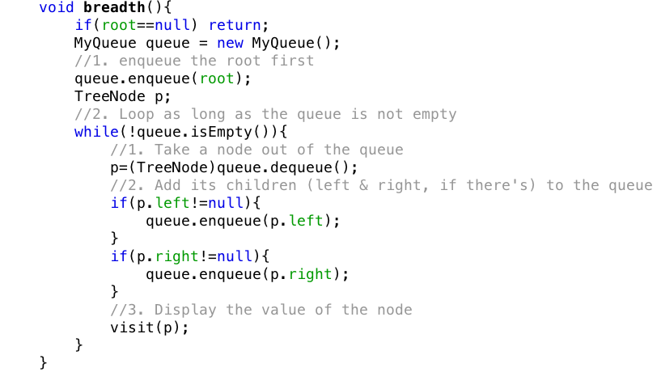
Breadth-first traversal

Slide 32
Depth first
There are three cases:
Pre-order: VLR (Visit – Left – Right), means at every node try to visit first (display the node first) then go its left subtree then its right subtree
In-order: LVR (Left – Visit – Right), means at every node try to go to the left subtree first, if at a node cannot go any further left then visit (display the node), then try to go to the right subtree.
Post-order: LRV (Left – Right – Visit), means at every node try to go all the way to left first, when at a node, cannot go left any further, then try to go right, if at a node cannot go left or right any further, then display the node.

Slide 33
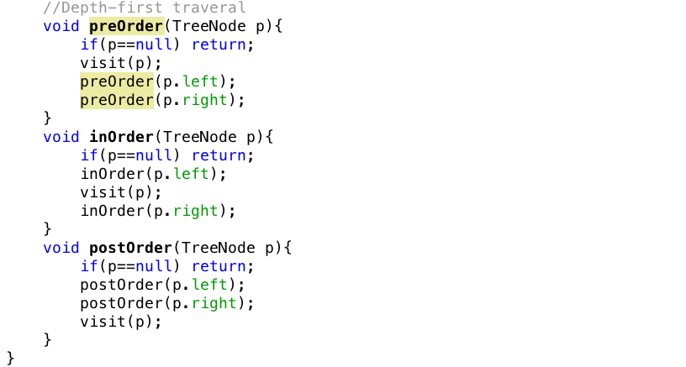
Depth first

Slide 34
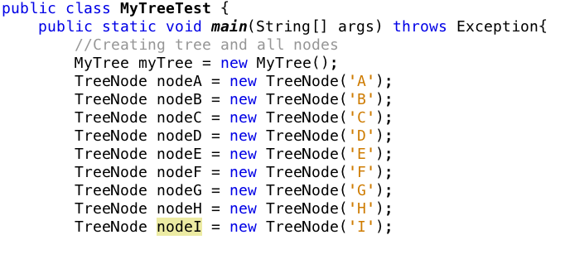
Test program

Slide 35
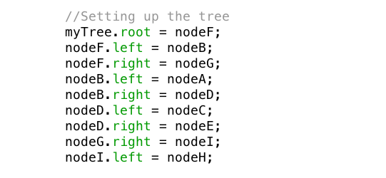
Setting up the tree

Slide 36
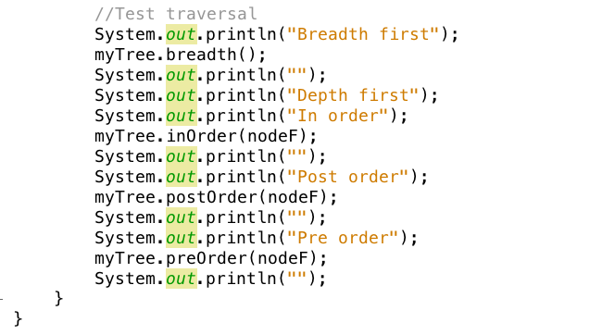
Traverse the tree

Slide 37
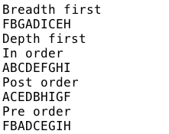
Output

Slide 38
Binary search trees

Slide 39
Binary Search Tree Definition
Binary Search Tree is a node based tree data structure which has following properties
Left subtree of a node contains only nodes with keys less than the node’s key
Right subtree of a node contains only nodes with keys greater than the node’s key
Both the left and right subtrees must also be binary search trees
From above definition, it’s naturally follows that
Each node has a distinct key (no equal)
An inorder traversal of a binary search tree visits the keys in increasing order

Slide 40
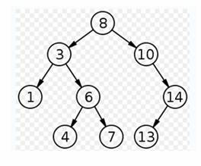
Binary search tree example

Slide 41
Implementing Binary Search Tree

Slide 42
Insertion on Binary Search Tree
4
20
15
null
15
15
4
19
17
15
15
15
4
20
4
20
4
20
17
17
19

Slide 43
Insertion on a Binary Search Tree
Check if root is null
Loop to find the last node
Check if x exists?
Turn left or right?
Insert
Left or right?

Slide 44
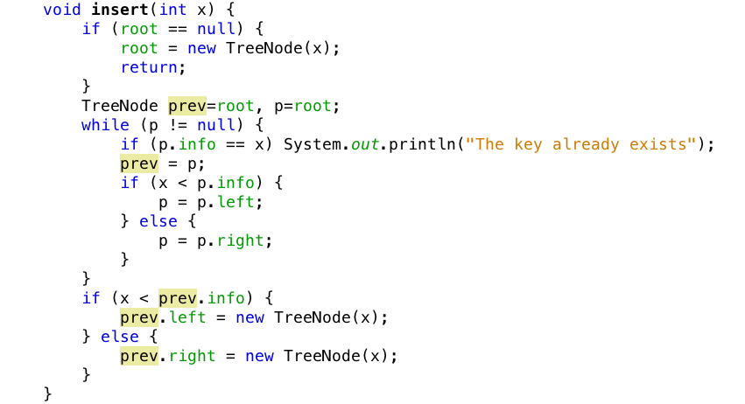
Insertion on a Binary Search Tree

Slide 45
Searching on Binary Search Trees
TreeNode search(TreeNode p, int x)
Check if p is null?
Check if p contains x?
Recursively search on left or right of p

Slide 46
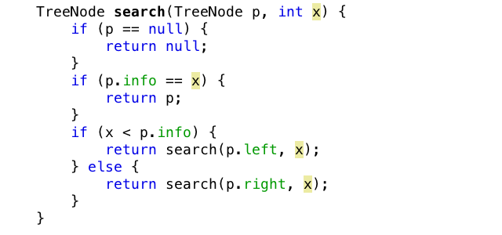
Searching on Binary Search Trees

Slide 47
The end

